Slide 1



React
Gal Amouyal gal.amouyal@ibm.com https://github.com/galamo

Slide 2
React
JavaScript library for building user interfaces

Slide 3
A busy Queue…
About React
React Concept
JavaScript for react
Functional programing
Imperative vs declarative
ECMA Latest features
Create react app

Slide 4
A busy Queue…
React Elements
Components
Class vs Functional Components
High Order Components
State and props
Hooks
Context API – if time permits

Slide 5
Eco System
Routing – React router DOM
React redux
Material Design / Bootstrap
Thunk

Slide 6
References
React Official Docs - https://reactjs.org/docs
Learning React by Eve Porcello, Alex Banks - https://learning.oreilly.com/library/view/learning-react/
https://www.youtube.com/watch?v=oPo4EQmkjvY&t=1828s
React 16 - The Complete Guide https://learning.oreilly.com/videos/react-16/9781789132229

Slide 7



React VS Angular

Slide 8
React
Google
JavaScript Framework
Full MVC
Regular DOM
Bi-Directional
TypeScript, HTML
Facebook 2011
JavaScript Library
View
Virtual DOM
Uni-directional
JSX, JS, Typescript

Slide 9
About React
Jordan Walke
React is a JavaScript library - one of the most popular ones, with over 140,000 stars on GitHub
Open-source project
React is used to build user interfaces (UI) on the front end.
View layer
Declarative
Efficient
Component based

Slide 10
React’s past and future
Fiber engine
Hooks
New lifecycle
Concurrent
Suspense
New Dev tools
https://reactjs.org/blog

Slide 11

Before we start…

Slide 12


Slide 13
Do we know JavaScript ?

Slide 14
What is the Call Stack ? Is it part of V8 ?
Part of V8 Engine ( in case chrome & nodejs)
Model that implemented by different browsers
Use to keep track on function invocations

Slide 15

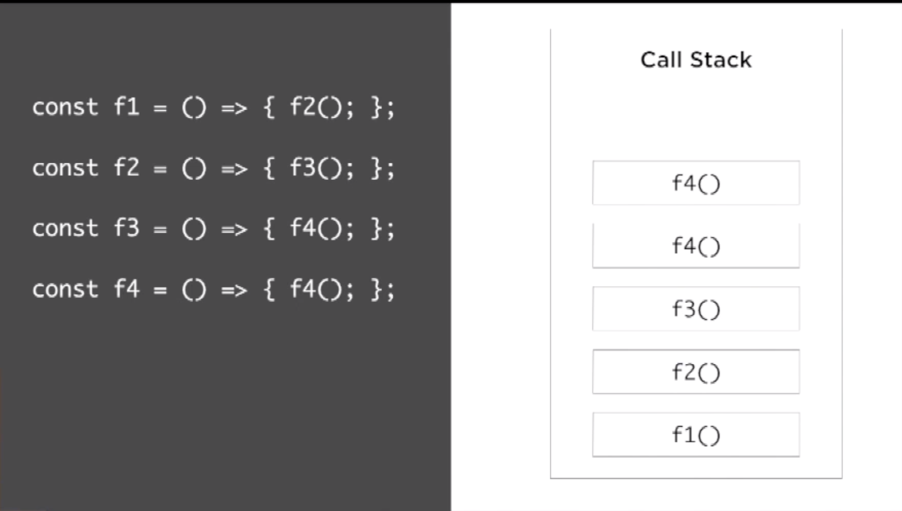
Busy Call Stack

Slide 16

What is the Event Loop? Is it part of V8 ?

Slide 17

Event Loop
Handles external events and convert them into callback invocation

Slide 18
Event Loop
A loop that picks events from the event queue and pushes their callbacks to call stack

Slide 19
Event Loop - example
Example

Slide 20
JavaScript for react
ECMA Latest features
Const
Let
Template strings
Arrow functions
Destructuring Objects & Arrays
Object literals
Async/Await
Es6 modules

Slide 21
Functional Programming
JavaScript functions are first class citizens
Last ECMA new features – Arrow functions, Promises etc..
Functions can represent data
Higher order function
Part of declarative programing

Slide 22
Imperative vs Declarative
Imperative
Declarative
How it Happen?
What should happen?

Slide 23

Let's do a little experiment
Ready ?

Slide 24
This code …
const string = "What is this code doing?";
let result = "";
for (let i = 0; i < string.length; i++) {
if (string[i] === " ") {
result += "-";
} else {
result += string[i];
}
}

Slide 25
Ready…
Ready ?

Slide 26
This code …
const string = "Restaurants in Tel aviv";
const urlFriendly = string.replace(/ /g, "-");

Slide 27
And the winner is ?
Replace the string to URL friendly

Slide 28

Round 2…
Ready ?

Slide 29
This code …
const users = [”Adi", ”Yochi", ”Ester"];
const newUsers = [];
for (let index = 0; index < users.length; index++) {
if (users[index].length > 3) {
newUsers.push(users[index]);
}
}

Slide 30

Easy…

Slide 31
…
const users = ["gal", "yochay", "lev"];
const newUsers = users.filter(user => user.length > 3);

Slide 32

Filter!!!

Slide 33
Imperative vs Declarative - Welcome
const target = document.getElementById("target");
const wrapper = document.createElement("div");
const headline = document.createElement("h1");
wrapper.id = "welcome";
headline.innerText = "Hello World";
wrapper.appendChild(headline);
target.appendChild(wrapper);

Slide 34
React way
const { render } = ReactDOM;
const Welcome = () => (
<div id="welcome">
<h1>Hello World</h1>
</div>
);
render(<Welcome />, document.getElementById("target"));
The render function uses the instructions declared in the component to build the DOM, abstracting away the details of how the DOM is to be rendered

Slide 35
More functional Concepts
Immutability
Pure functions
Data transformations - High order function
recursion

Slide 36
Immutability
Unchangeable
Data is immutable
Return a Copy

Slide 37
mutation - exmaple
let color_book = {
title: "book",
color: "#00FF00",
rating: 0
};
function rateColor(color, rating) {
color.rating = rating;
return color;
}
console.log(rateColor(color_book, 5).rating); // 5
console.log(color_book.rating); // 5

Slide 38
Immutability - exmaple
const rateColor = function(color, rating) {
return Object.assign({}, color, { rating: rating });
};
console.log(rateColor(color_book, 5).rating); // 5
console.log(color_book.rating); // 4

Slide 39
Immutability - example
const rateColor = (color, rating) => ({
...color,
rating
});

Slide 40
Pure function
Returns a value that is computed based on its arguments
At least one argument
Always return a value or another function
No side effects
Arguments as immutable data
Testable

Slide 41
Pure function - example
const frederick = {
name: "Frederick Douglass",
canRead: false,
canWrite: false
};
const selfEducate = person => ({
...person,
canRead: true,
canWrite: true
});
console.log(selfEducate(frederick));
console.log(frederick);

Slide 42
DOM Side effects
function Header(text) {
let h1 = document.createElement("h1");
h1.innerText = text;
document.body.appendChild(h1);
}
Header("Header() caused side effects");

Slide 43
Pure function \ component – react way
const header = text => <h1> {text} </h1>;

Slide 44
Higher order functions
Manipulate other functions
Takes functions as arguments
Return functions

Slide 45
Higher order functions
const invokeIf = (condition, fnTrue, fnFalse) =>
condition ? fnTrue() : fnFalse();
const showWelcome = () => console.log("Welcome!!!");
const showUnauthorized = () => console.log("Unauthorized!!!");
invokeIf(true, showWelcome, showUnauthorized); // "Welcome!!!"
invokeIf(false, showWelcome, showUnauthorized); // "Unauthorized!!!"

Slide 46
Data Transformation
Reduce
Map
Filter
Find
Findindex

Slide 47
Data Transformation
const editName = (oldName, name, arr) => {
return arr.map(item => {
return item.name === oldName ? { ...item, name } : item;
});
};

Slide 48
Composition
Small pure functions, focus each function in a specific task
Combine functions to larger function
Chainable

Slide 49
Composition
const civilianHours = clockTime => ({
...clockTime,
hours: clockTime.hours > 12 ? clockTime.hours - 12 : clockTime.hours
});
const appendAMPM = clockTime => ({
...clockTime,
ampm: clockTime.hours >= 12 ? "PM" : "AM"
});
const both = date => appendAMPM(civilianHours(date));

Slide 50
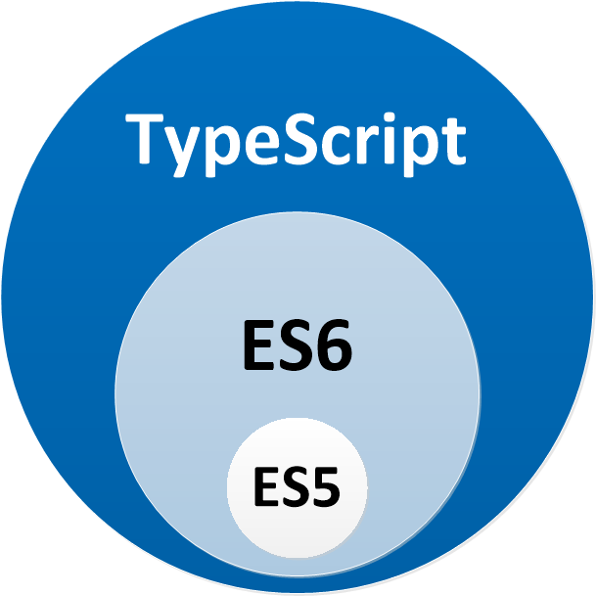
Typescript

Slide 51
Typescript
Microsoft
JavaScript that scales
Typescript compiler
Interfaces
Strongly types
Classes modifiers
More…

Slide 52
React core concepts
React Element
JSX
Components and props
Virtual DOM
Render
State
Lifecycle

Slide 53
Thinking in react
Break The UI Into A Component Hierarchy
Data Model
Identify The Minimal Representation Of UI State
Identify Where Your State Should Live
Add Inverse Data Flow

Slide 54
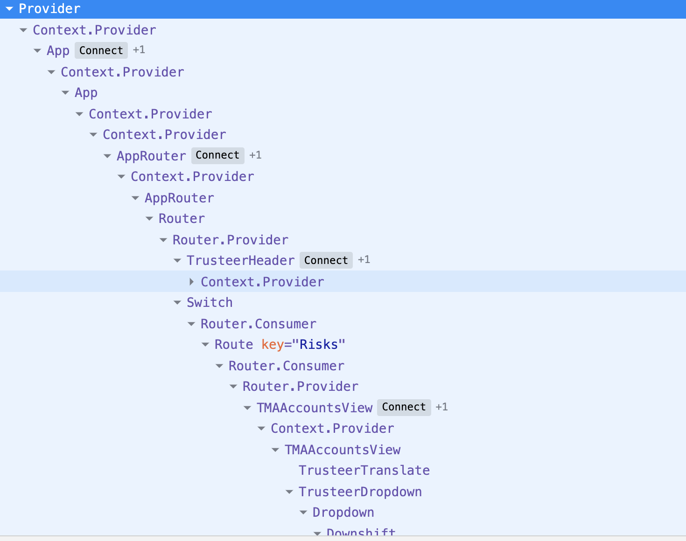
React Component Hierarchy

Slide 55
How react works
Can use 2 minimal libs
React - Generate views
React DOM - render the UI in the browser
React designed to update the DOM for us

Slide 56
React Create App
Create react app is a comfortable environment for learning React and is the best way to start building a new single-page application in React.

Slide 57
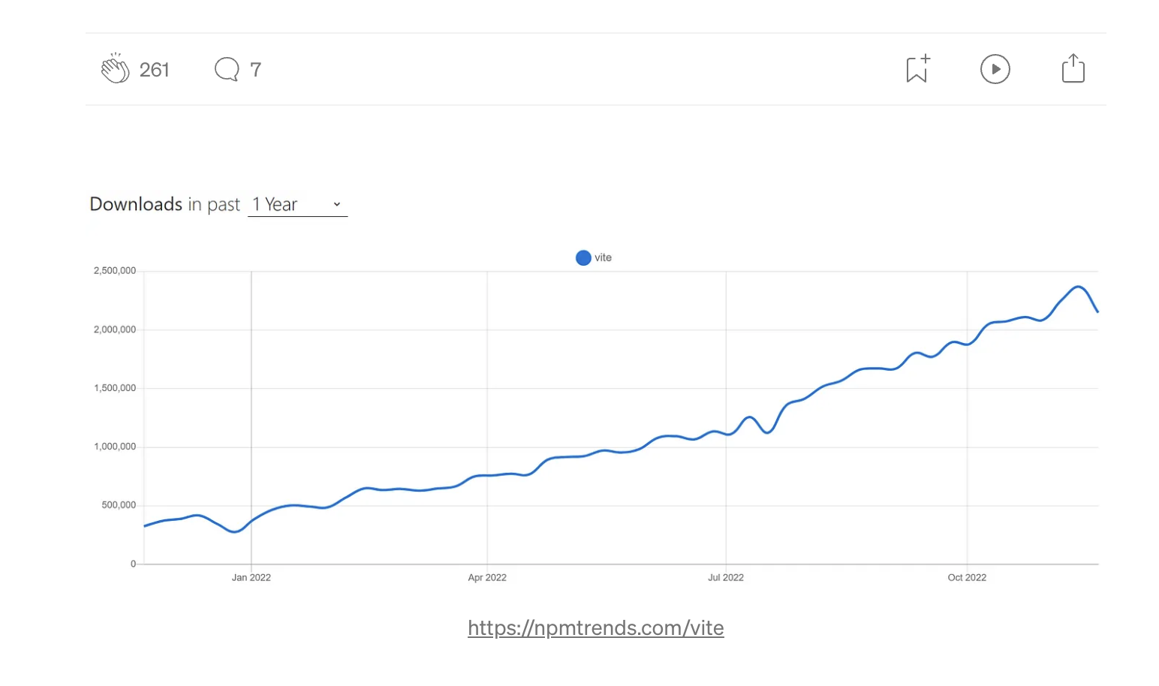
Vite

Slide 58
Vite
Native ES modules
Rollup

Slide 59
React Create App
npm install -g create-react-app

Slide 60
React Create App – new Project
npx create-react-app my-app –typescript
npm install --save typescript @types/node @types/react @types/react-dom @types/jest

Slide 61
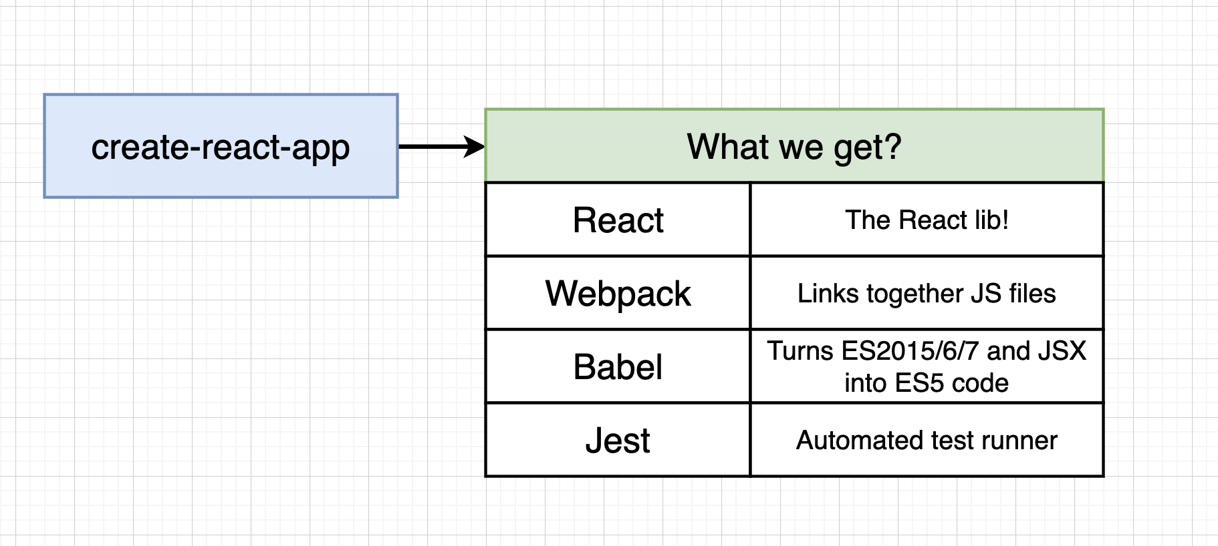
React CLI

Slide 62
Project Structure
Ui Components
Main Components – Pages
Utils
Configurations
State management – redux

Slide 63
DOM Element
Browser DOM
DOM Elements
DOM Elements
DOM Elements

Slide 64
React Element
React DOM
React Elements
React Elements
React Elements

Slide 65
React Element
The most atomic Unit in react
React elements are the instructions for how the browser DOM should be created.
HTML Tags are become DOM elements when the browser loads the HTML
React.CreateElement – working with the DOM API
Instructions for what we want React to build
Rendering and reconciling the elements

Slide 66
React Element
<h1 id=”h1-app">Application Header</h1>
{
$$typeof: Symbol(React.element),
"type": "h1",
"key": null,
"ref": null,
"props": {id: ”h1-app", children: "Application Heade "},
"_owner": null,
"_store": {}
}

Slide 67
React Children
React renders child elements using props.children
Element tree
<ul>
<li>2 lb salmon</li>
<li>5 sprigs fresh rosemary</li>
<li>2 tablespoons olive oil</li>
<li>2 small lemons</li>
<li>1 teaspoon kosher salt</li>
<li>4 cloves of chopped garlic</li>
</ul>

Slide 68
React Children
React.createElement(
"ul",
null,
React.createElement("li", null, "2 lb salmon"),
React.createElement("li", null, "5 sprigs fresh rosemary"),
React.createElement("li", null, "2 tablespoons olive oil"),
React.createElement("li", null, "2 small lemons"),
React.createElement("li", null, "1 teaspoon kosher salt"),
React.createElement("li", null, "4 cloves of chopped garlic")
);

Slide 69
ClassName in react
HTML Elements use class attribute
Class is reserved word
React use className
Style object is also available

Slide 70
ClassName in react
React.createElement(
"ul",
{ className: ” ingredients " },
ingredients.map(item => React.createElement("li", null, item))
);
const items = [
"2 lb salmon",
"5 sprigs fresh rosemary",
"2 tablespoons olive oil",
"2 small lemons",
"1 teaspoon kosher salt",
"4 cloves of chopped garlic"
];

Slide 71
Problem
Writing all our application with Create Element
is time consuming

Slide 72

Solution
JSX
on the beach!

Slide 73
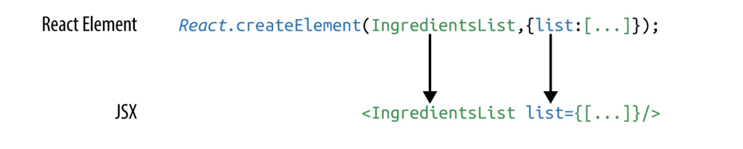
JSX
concise syntax
Easy to create DOM trees with attributes
More readable like HTML & XML
Using JS expressions ..{}

Slide 74
Mapping Arrays with JSX
<ul>
{props.ingredients.map((ingredient, i) => (
<li key={i}>{ingredient}</li>
))}
</ul>

Slide 75
Babel
Convert our fancy source code into something
that the browser can interpret

Slide 76
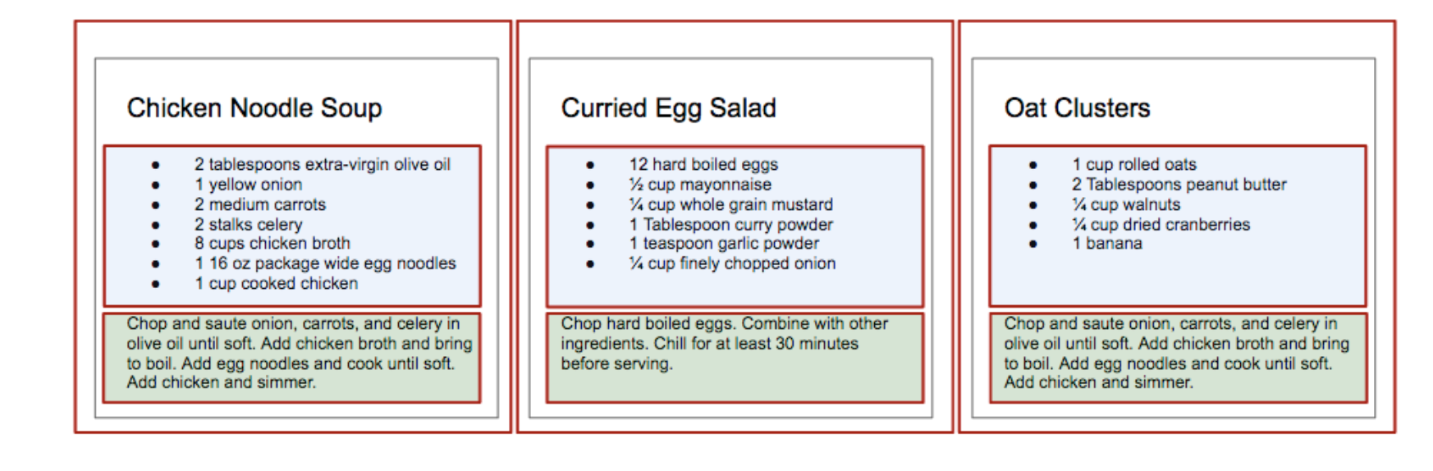
Components
User interface is made up of parts
When we put them all together we are getting user interface
Independent
reusable pieces

Slide 77
Components
Class
Function

Slide 78
Function Component
import React from "react";
interface Props {
title: string;
color: string;
}
function Header(props: Props) {
const { title, color } = props;
return (
<h1 className="jumbotron" style={{ color }}>
{" "}
{title}{" "}
</h1>
);
}

Slide 79
Class Component
export class Header extends React.Component<Props, any> {
constructor(props: Props) {
super(props);
}
render() {
const { title, color } = this.props;
return (
<h1 className="jumbotron" style={{ color }}>
{title}
</h1>
);
}
}

Slide 80
Props
Object
Props are stands for properties which passed to the components
Props are read only
Props can contain primitive and complex data

Slide 81
React Fragments
Container
Avoid DIV Hell

Slide 82
Stateless Component
Component is just a plain JavaScript function
which takes props as an argument and
returns a react element

Slide 83
Stateful Component
Component that contains State object
and reflect their state with the render process

Slide 84
The State
The state of a React application is driven by data that has the ability to change
Reflect the content - UI

Slide 85
Using the state
Don’t change the state directly
Use setState mothod
React may batch multiple setState() calls into a single update for performance
State updates are merged

Slide 86
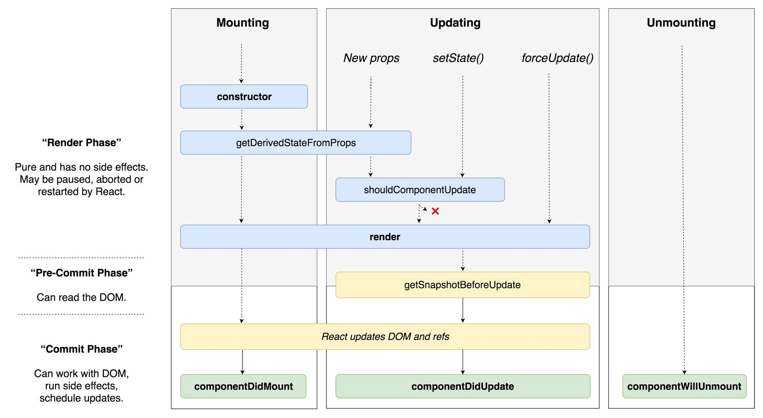
Components lifecycle methods

Slide 87
mounting
These methods are called in the following order when an instance of a component is being created and inserted into the DOM:
constructor()
static getDerivedStateFromProps()
render()
componentDidMount()

Slide 88
getDerivedStateFromProps()
Before render
Return object that updates the state
When state depends on props – AntiPattern
Fetch data on props changed

Slide 89
render()
React Element tree is created
React updates his virtual DOM

Slide 90
ComponentDidMount()
Invoked immediately after a component is mounted - inserted into the tree
Call remote endpoint
Subscriptions

Slide 91
Updating
An update can be caused by changes to props or state. These methods are called in the following order when a component is being re-rendered:
static getDerivedStateFromProps()
shouldComponentUpdate()
render()
getSnapshotBeforeUpdate()
componentDidUpdate()

Slide 92
shouldComponentUpdate()
Invoked before rendering when new props or state are being received.
Help us to decide if the state changes need to affect the component render
Return Boolean value
Default true

Slide 93
getSnapshotBeforeUpdate()
Before the last render committed to the DOM
Capture information from the DOM
passed as a parameter to componentDidUpdate()

Slide 94
componentDidUpdate()
Invoked immediately after updating occurs
Not after initial render
SetState ? Be carful from infinite loop

Slide 95
Unmount
This method is called when a component is being removed from the DOM:
ComponentWillUnmount()

Slide 96
Routing
Navigation Bar
<Link to="/home">Home</Link>
Single Route = Page
<BrowserRouter>
<Switch>
<Route path="/signIn" component={SignIn} />
<Route path="/signup" component={SignUp} />
<Route path="/home" component={Home} />
<Route path="**" component={() => <h1> Not Found! </h1>} />
</Switch>
</BrowserRouter>

Slide 97
Routing
npm I react-router-dom

Slide 98
Virtual DOM
Real DOM – Document Object Model
Tree Data structure – Fast
UI re-rendering or repainting is heavy
Virtual DOM – virtual representation, saved in memory
Every time that our state changed the virtual DOM is updated

Slide 99
Virtual DOM
State changed => New virtual tree created
The tree is compared or “diffed” with the previous
Calculates the best possible way to apply the changes

Slide 100
How does React use Virtual DOM
React use observable pattern
Listen to state changes
New version of virtual DOM diffing with the old
Once react know what object are changed
It updated only the changed object on the real DOM

Slide 101
Virtual DOM – batch update
React follow a batch update mechanism to update the real DOM
No manipulating the DOM every single change

Slide 102
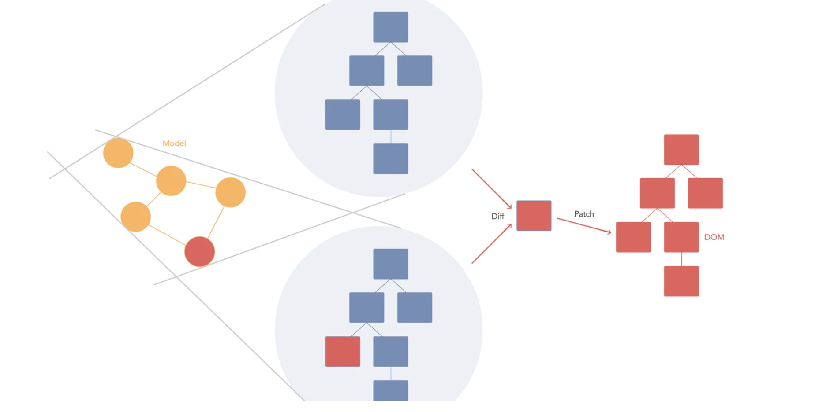
Virtual DOM

Slide 103
Reconciliation
Two elements of different types will produce different trees.
The developer can hint at which child elements may be stable across different renders with a key prop.

Slide 104
Reconciliation – The Diffing Algorithm
Root element type – different ?
DOM element same type, check the attribute
Children's compare
Using the Key

Slide 105
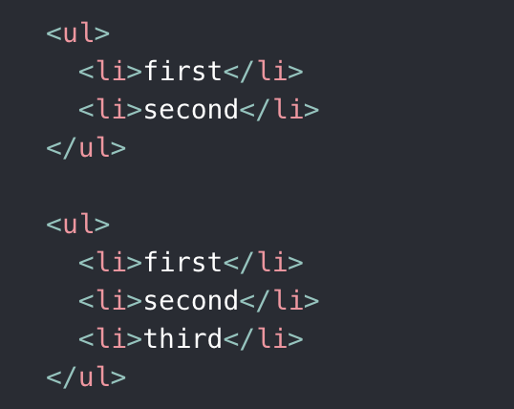
Reconciliation – Children's
React iterates both lists and generate mutation over the diff

Slide 106
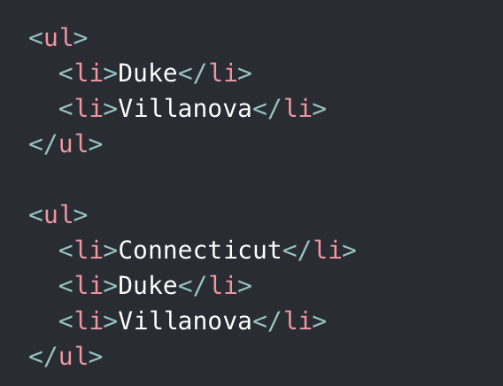
Reconciliation – Children's
React will Mutate every child

Slide 107
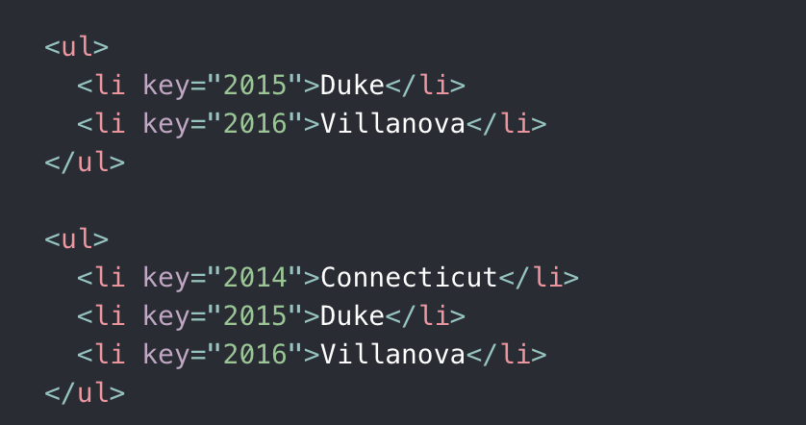

Slide 108
HOC
A higher-order component is a function that takes a component and returns a new component.
Reuse Logic

Slide 109
HOC
Take a Component as argument
Return Component

Slide 110
What sucks ?
It’s hard to reuse stateful logic between components
Complex components become hard to understand
Classes confuse both people and machines

Slide 111
Hooks
React Hooks are functions that let us hook into the React state and lifecycle features from function components

Slide 112
Rules of Hooks
Only call Hooks at the top level. Don’t call Hooks inside loops, conditions, or nested functions.
Only call Hooks from React function components.

Slide 113
useState
Managing state inside function component

Slide 114
useEffect
For side effects – event handlers, async request, etc…

Slide 115
Authentication HOC
Sync - check if token exist
Async – Validate the token
Return the relevant component

Slide 116
useEffect
For side effects – event handlers, async request, etc…

Slide 117
useRef
Access the DOM directly
Mutating ref

Slide 118
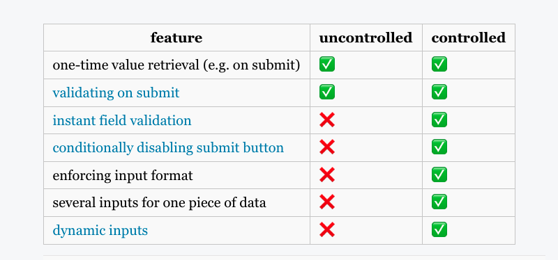
Controller components vs uncontrolled

Slide 119
useCallback & useMemo
The React useCallback Hook returns a memoized callback function.
The React useMemo Hook returns a memoized value.

Slide 120
Code splitting
your app grows, your bundle will grow too
“splitting” your bundle
Webpack

Slide 121
Suspense
Expiramental
Suspense is not a data fetching library. It’s a mechanism for data fetching libraries
We should make it as easy as possible to build apps that start fast and stay fast
Suspense is a feature for managing asynchronous operations in a React app. It lets your components communicate to React that they’re waiting for some data.

Slide 122
Suspense
Parallel data and view trees
Fetch in event handlers
Load data incrementally
Treat code like data

Slide 123
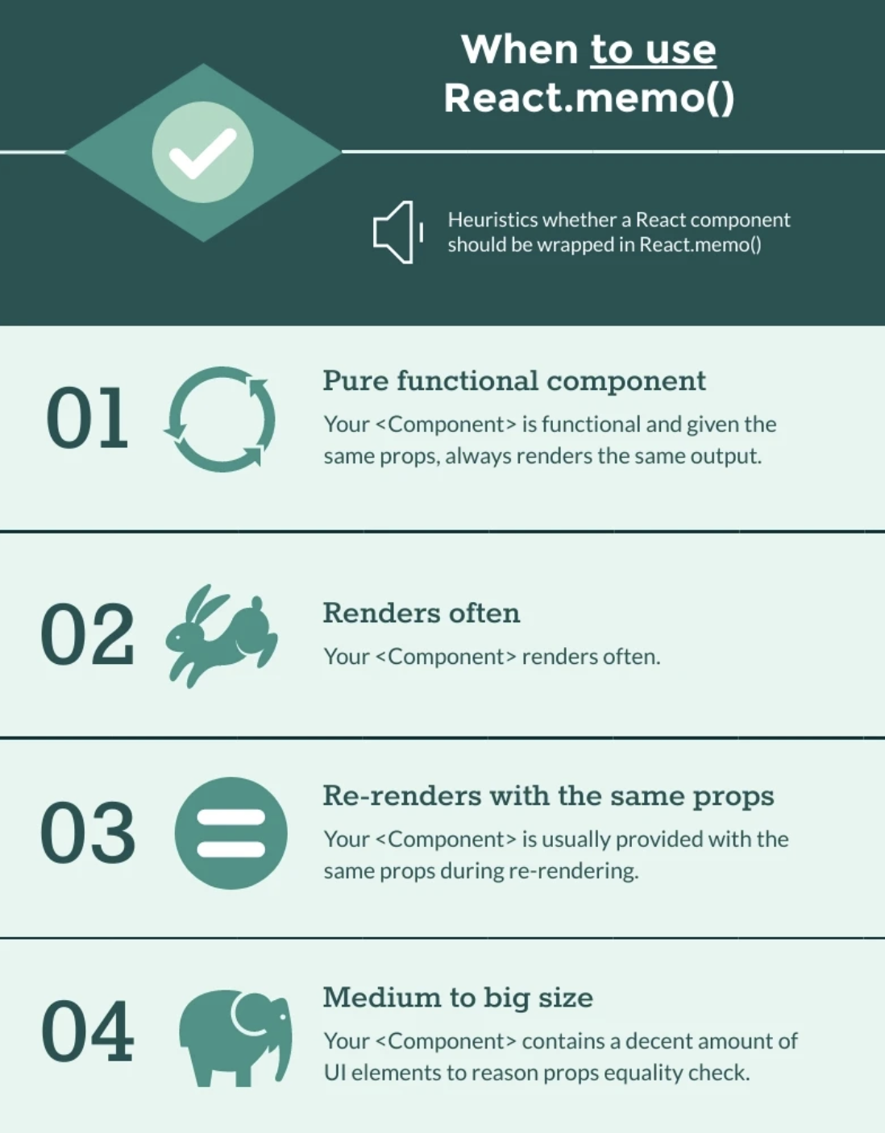
React.memo

Slide 124
React.memo

Slide 125
Problem – Global State Management
Inputs
Forms
Routing
Date pickers
Menus
Tabs
Filters

Slide 126

Problem – Global State Management
Data

Slide 127
Redux
The application has a central / root state.
A state change triggers View updates.
Only special functions can change the state.
A user interaction triggers these special, state changing functions.
Only one change takes place at a time.

Slide 128
Redux
Store
GetState
Dispatch
Subscribe
Action
Reducers

Slide 129
Redux toolkit
Configure store
Create reducer
Create slice
Create async thunk

Slide 130
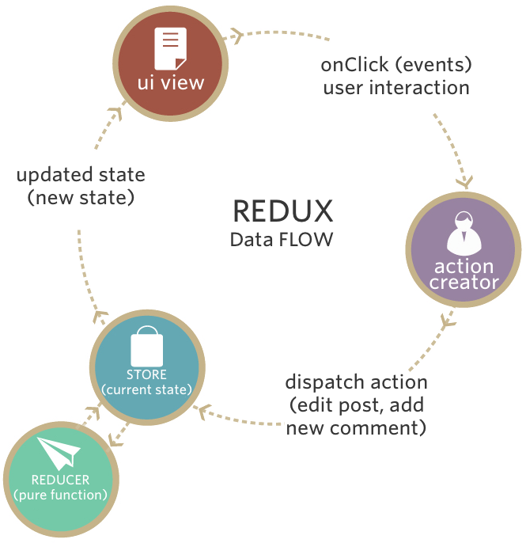
Redux

Slide 131
More Options
MobX
useContext

Slide 132
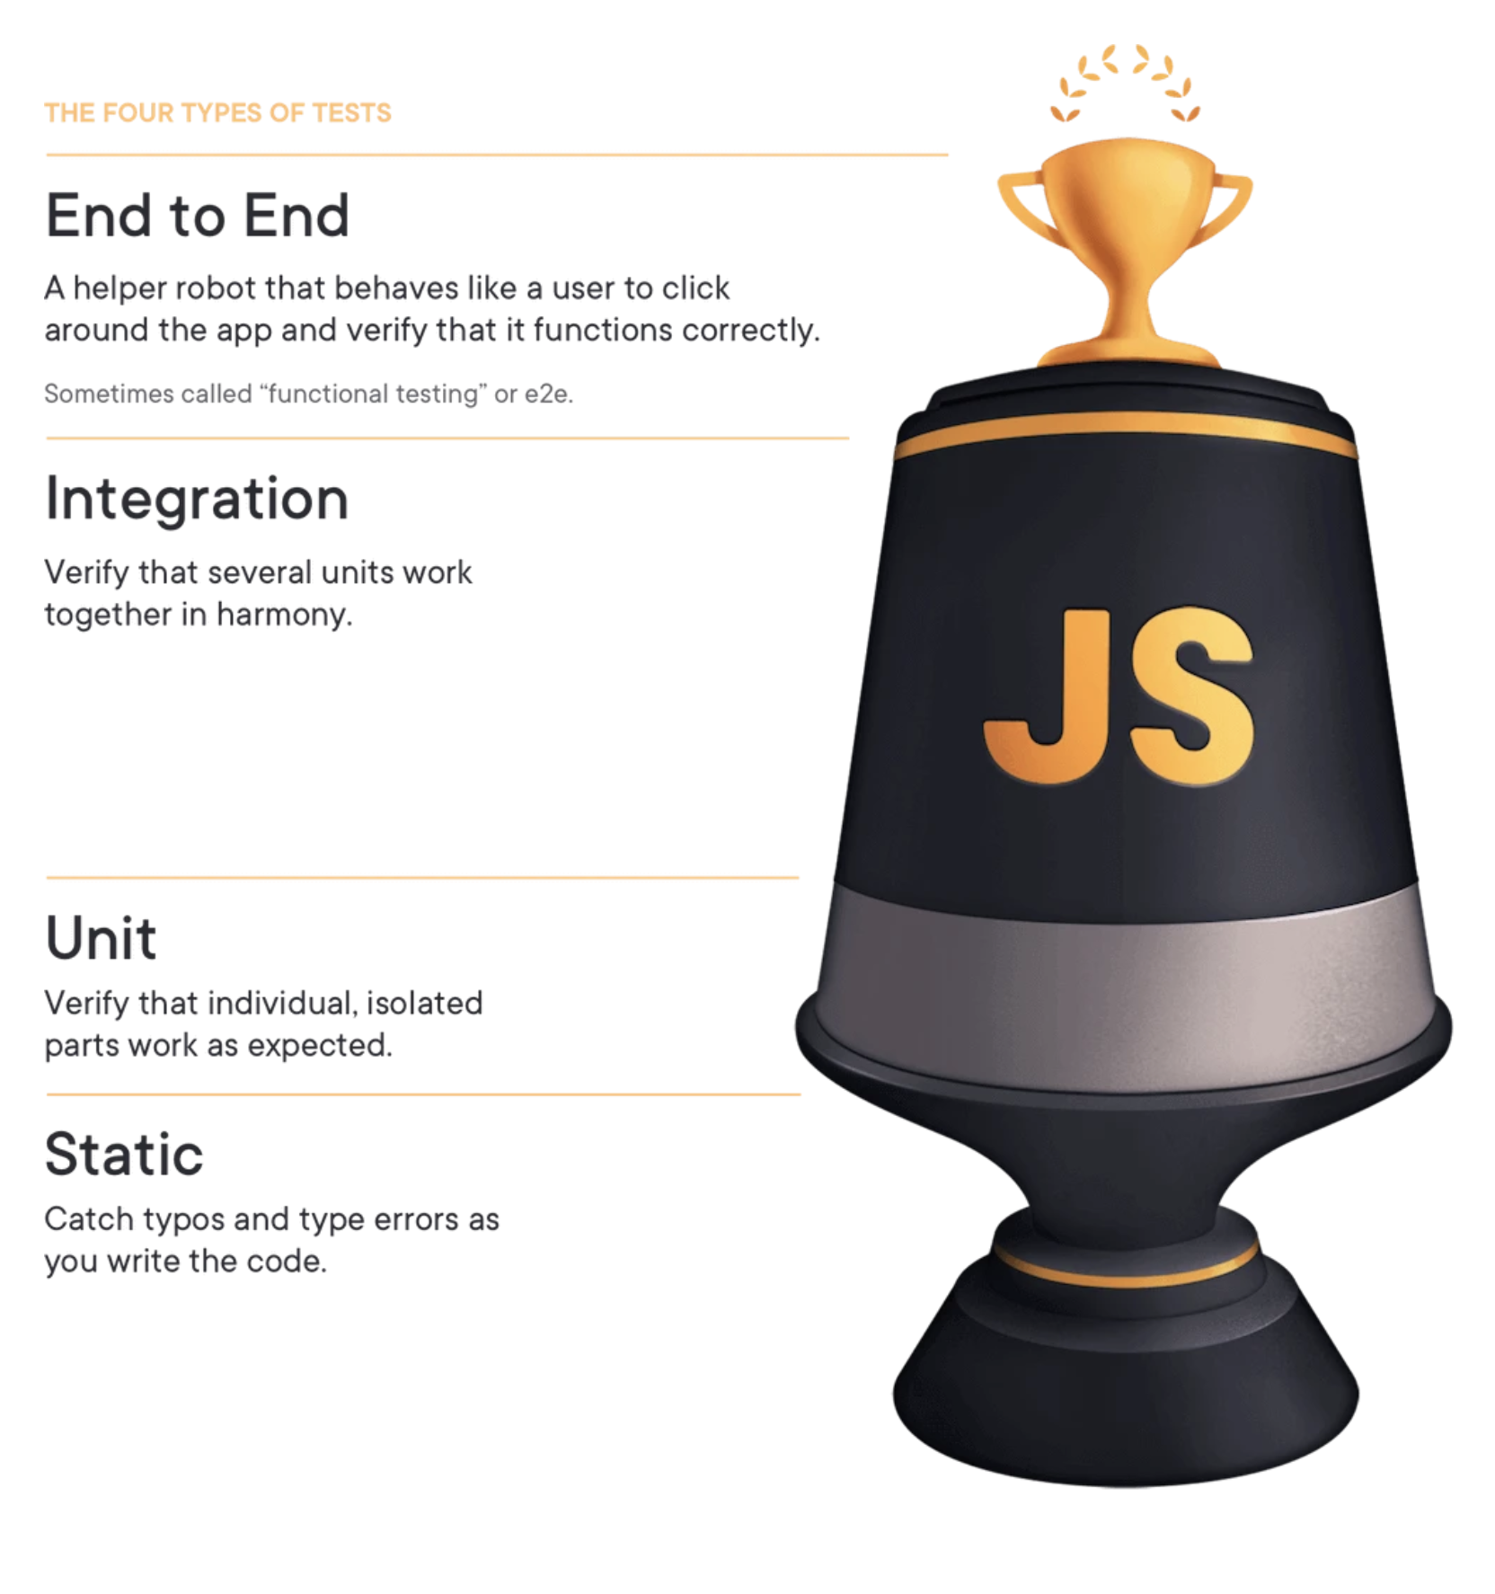
React Testing

Slide 133
Testing tradeoffs
Cost
Speed
Complexity

Slide 134
Distinctions
I don't really care about the distinctions.

Slide 135
Testing options
Rendering component trees
Running a complete app

Slide 136
Testing tradeoffs
Iteration speed vs Realistic environment
How much to mock

Slide 137
Tools
Jest ( using jsdom )
React Testing library

Slide 138
Style Components
Using tagged template literals and arrow functions in ES6+ and CSS, styled-components is a React-specific CSS-in-JS styling solution that creates a platform for developers to write actual CSS code to style React components.

Slide 139

THANKS! galamouyal88@gmail.com

